Slide 1

Welcome!
Grab a drink, food, and chat with your fellow makers.
July 26, 2016

Slide 2

What is Open Hardware?
Open (Source) Hardware, or OSHW, is “hardware whose design is made publicly available so that anyone can study, modify, distribute, make, and sell the design or hardware based on that design.”

Slide 3
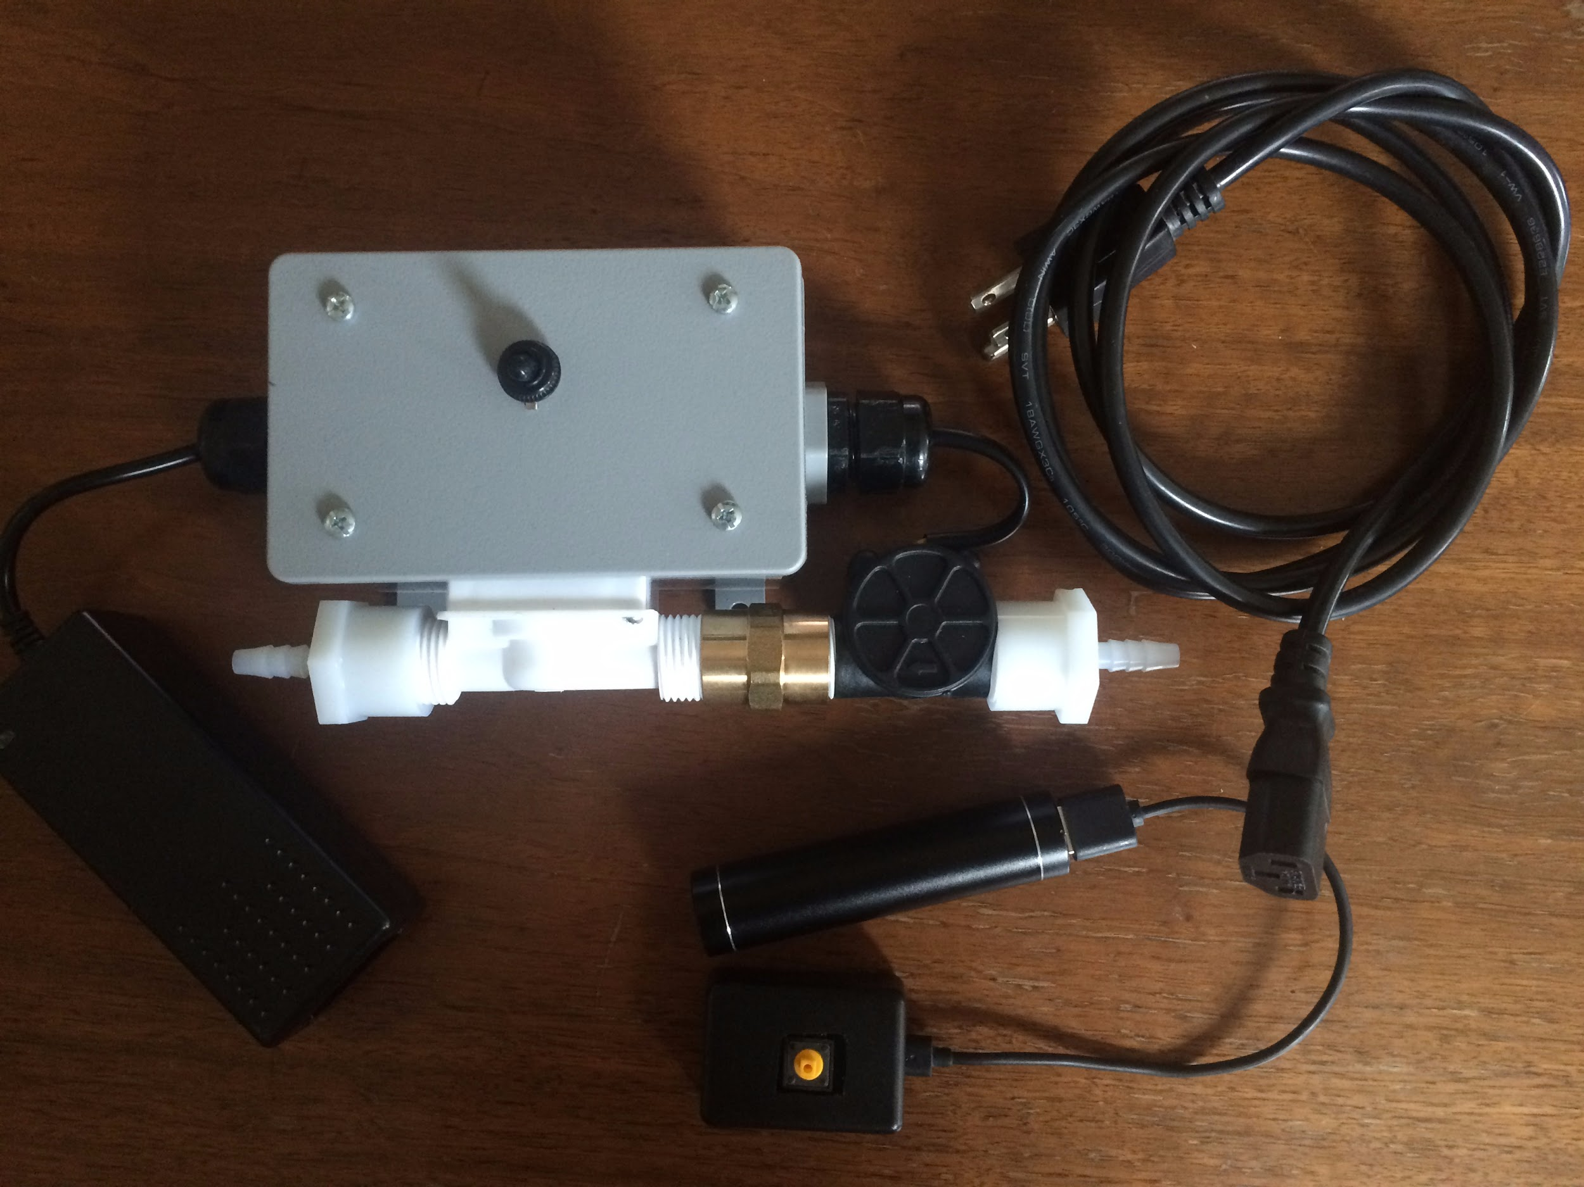
Keg Keeper
Goal:
Access control for kegerator system
https://github.com/IndyOpenHardware/slide-decks/blob/master/IOH%20Meeting%20072616.pptx
https://github.com/RuhtraRon/kegkeeper

Slide 4
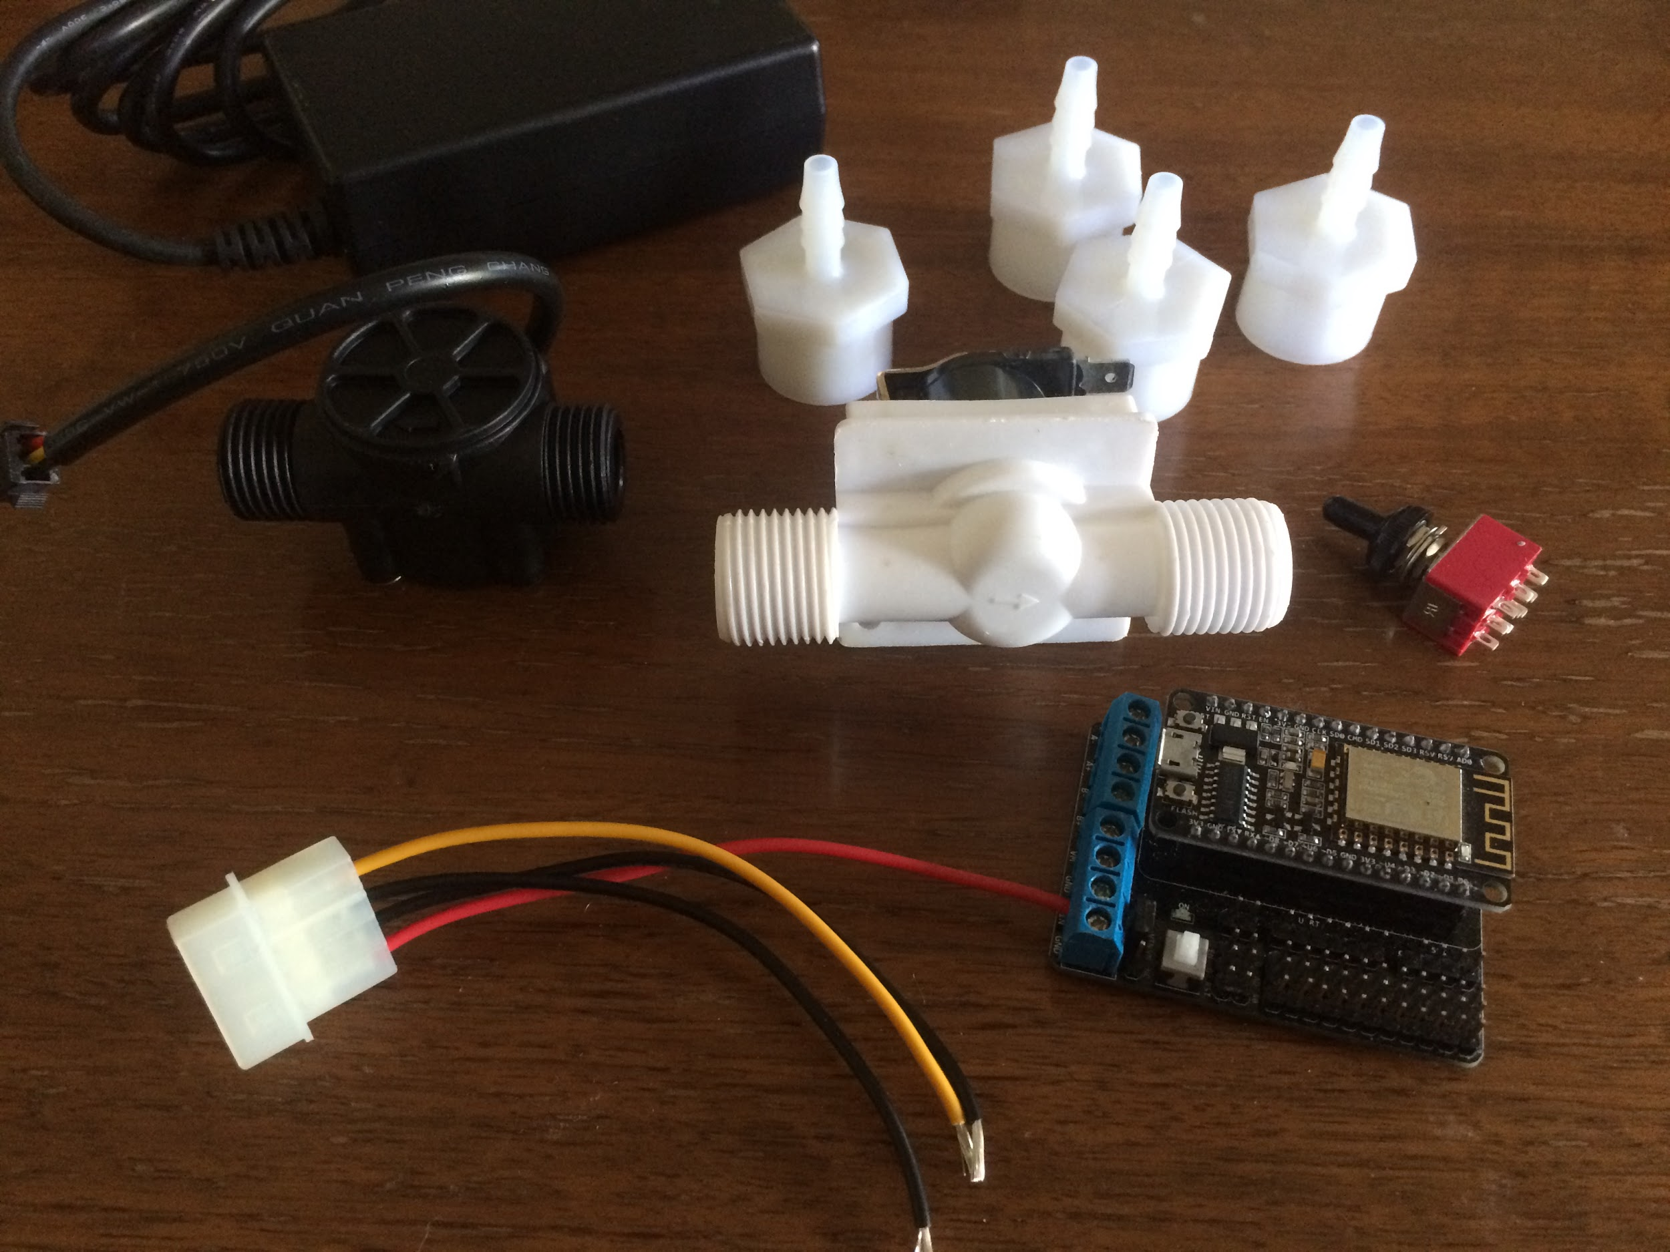
Bill of Materials:
Liquid Fluid Valve
Liquid Flow Meter
nodeMCU Dev Board
nodeMCU Motor Shield
3PDT Switch
½” FNTP to ¼” Barb fitting
12VDC / 5VDC Power Supply
Enclosure

Slide 5
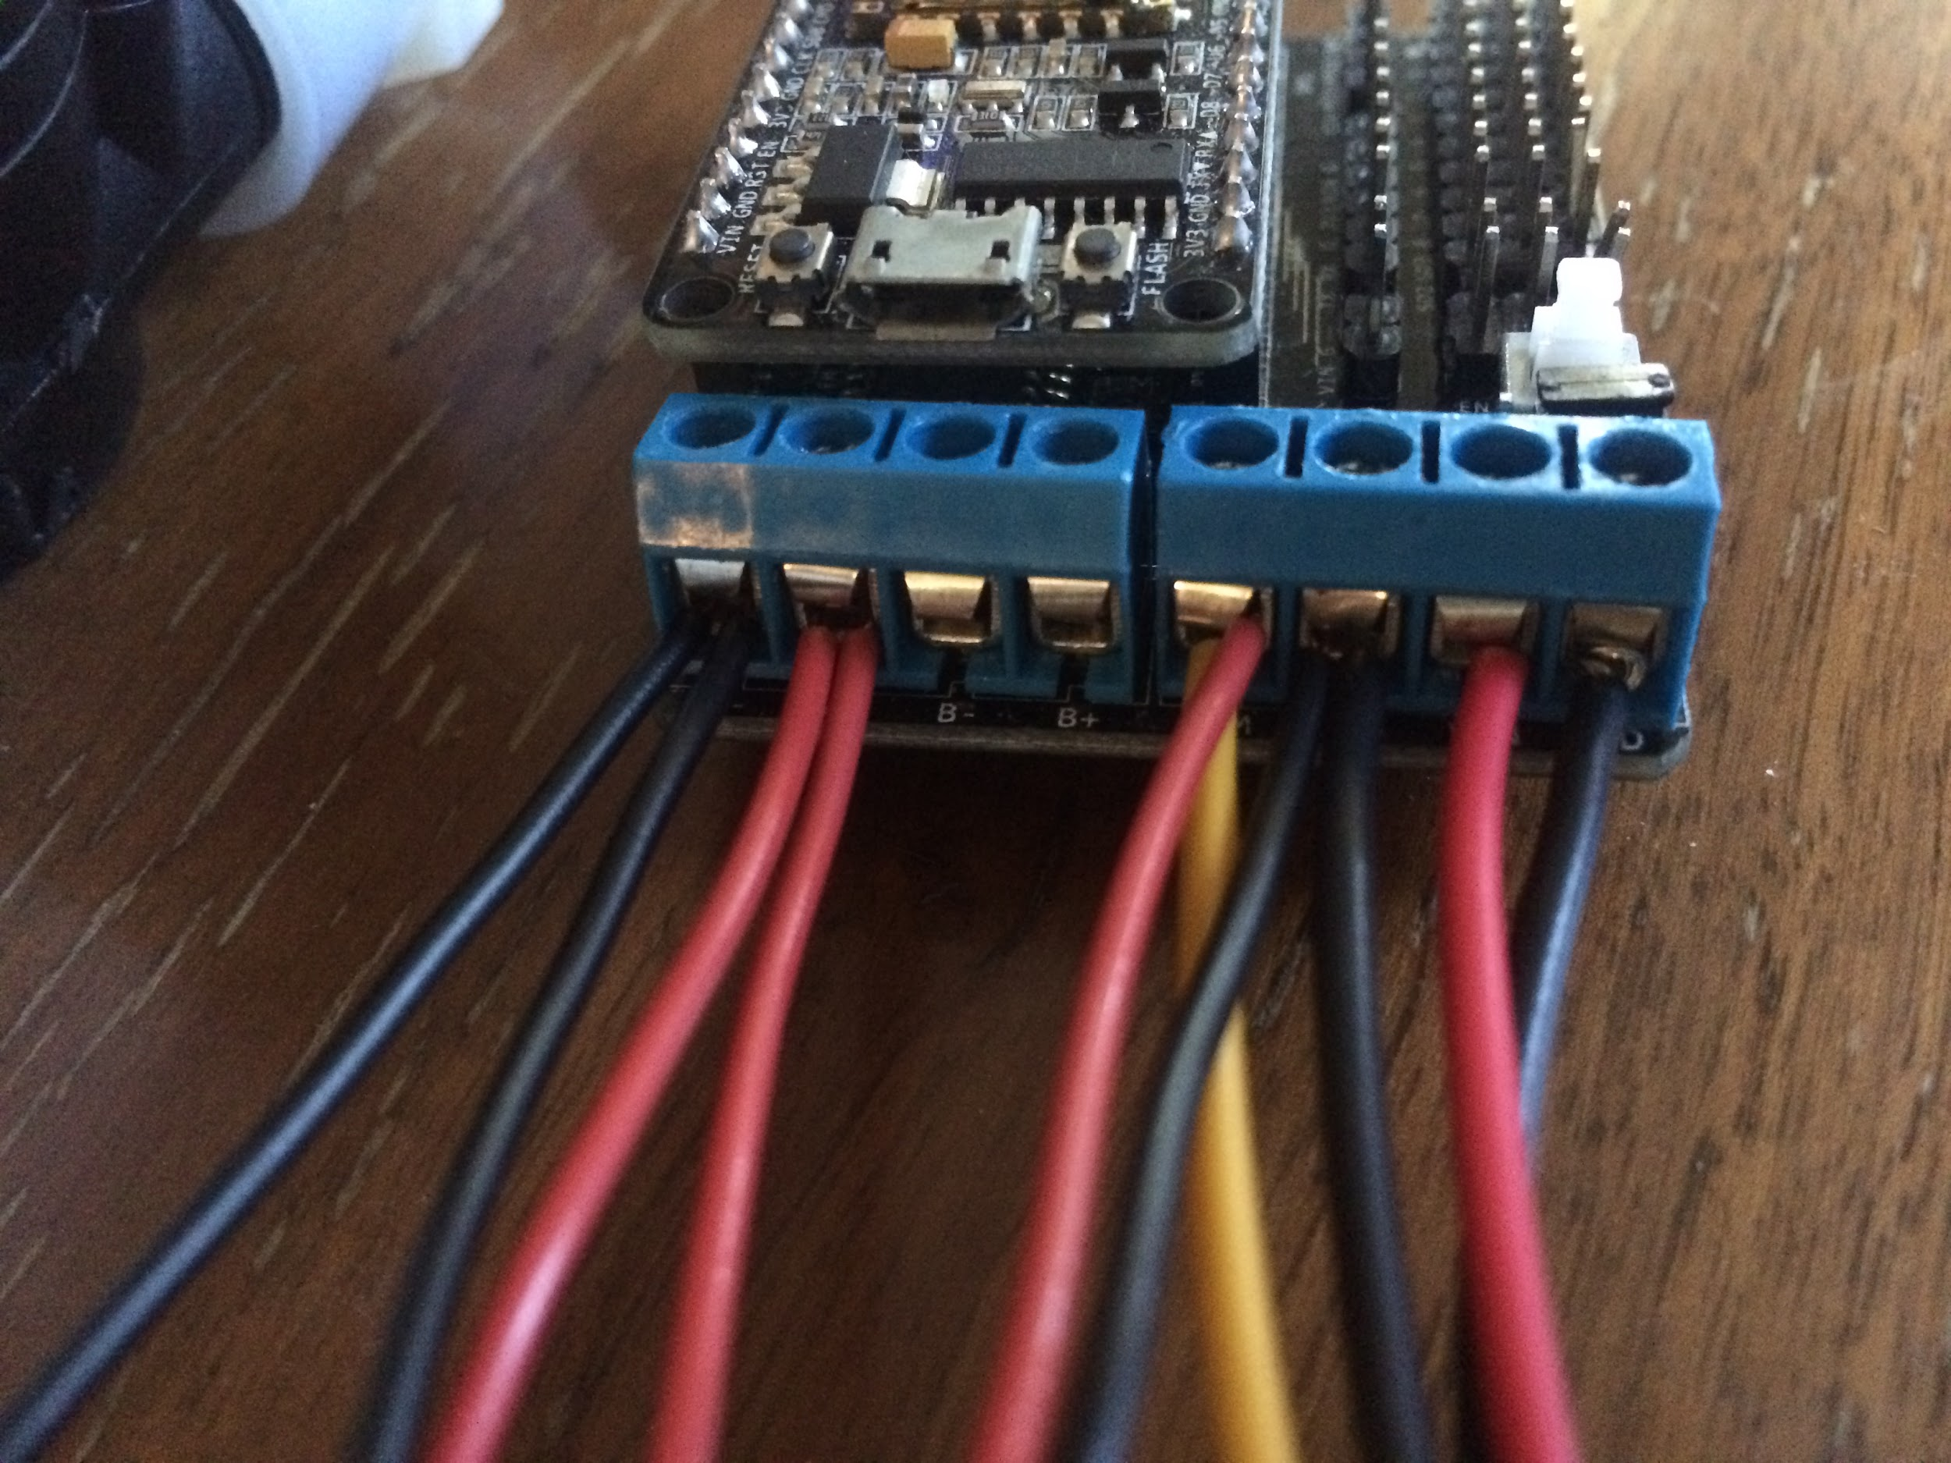
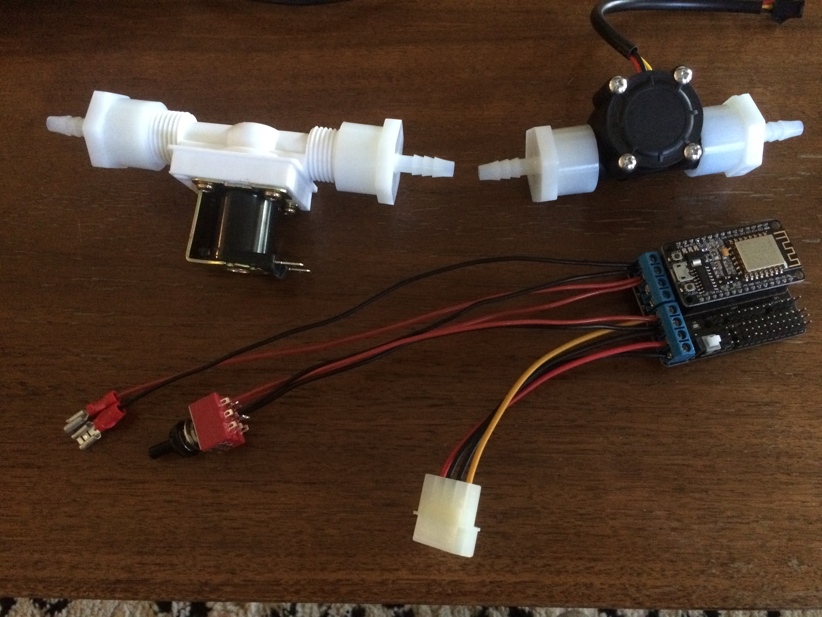
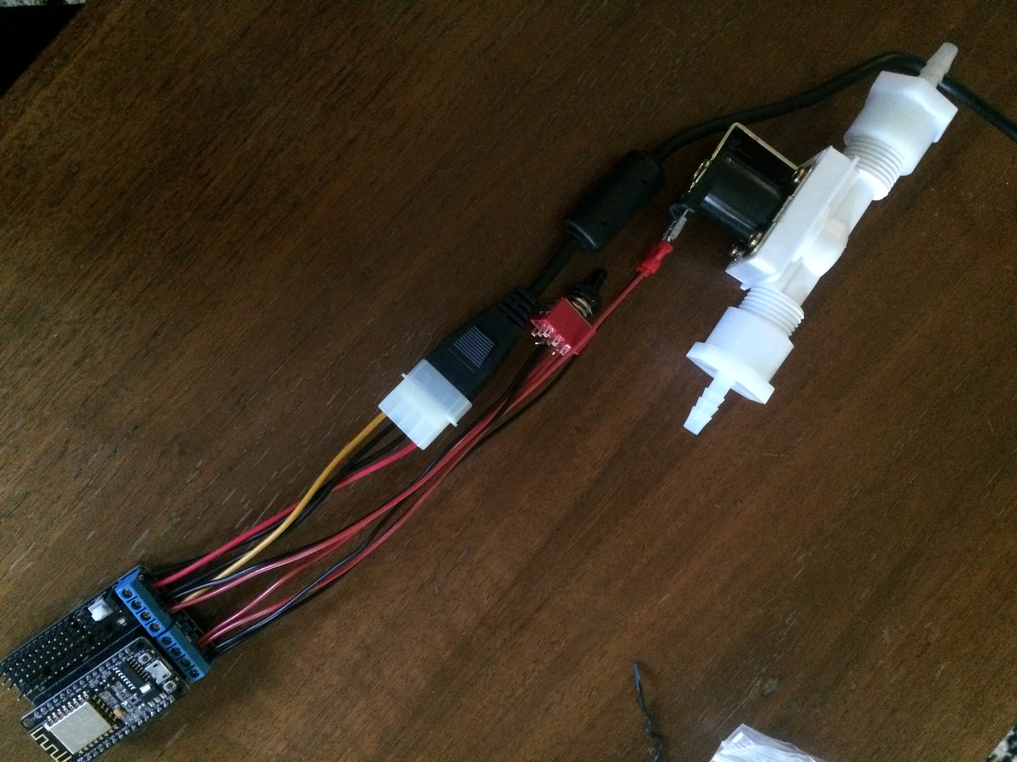
Electrical Assembly:
Liquid Fluid Valve
Liquid Flow Meter
nodeMCU Dev Board
nodeMCU Motor Shield
3PDT Switch
½” FNTP to ¼” Barb fitting
12VDC / 5VDC Power Supply
Enclosure

Slide 6
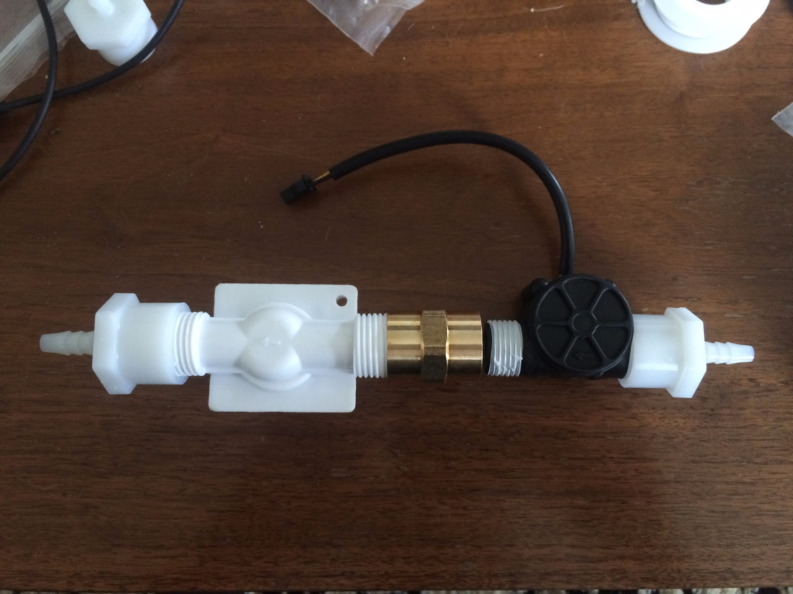
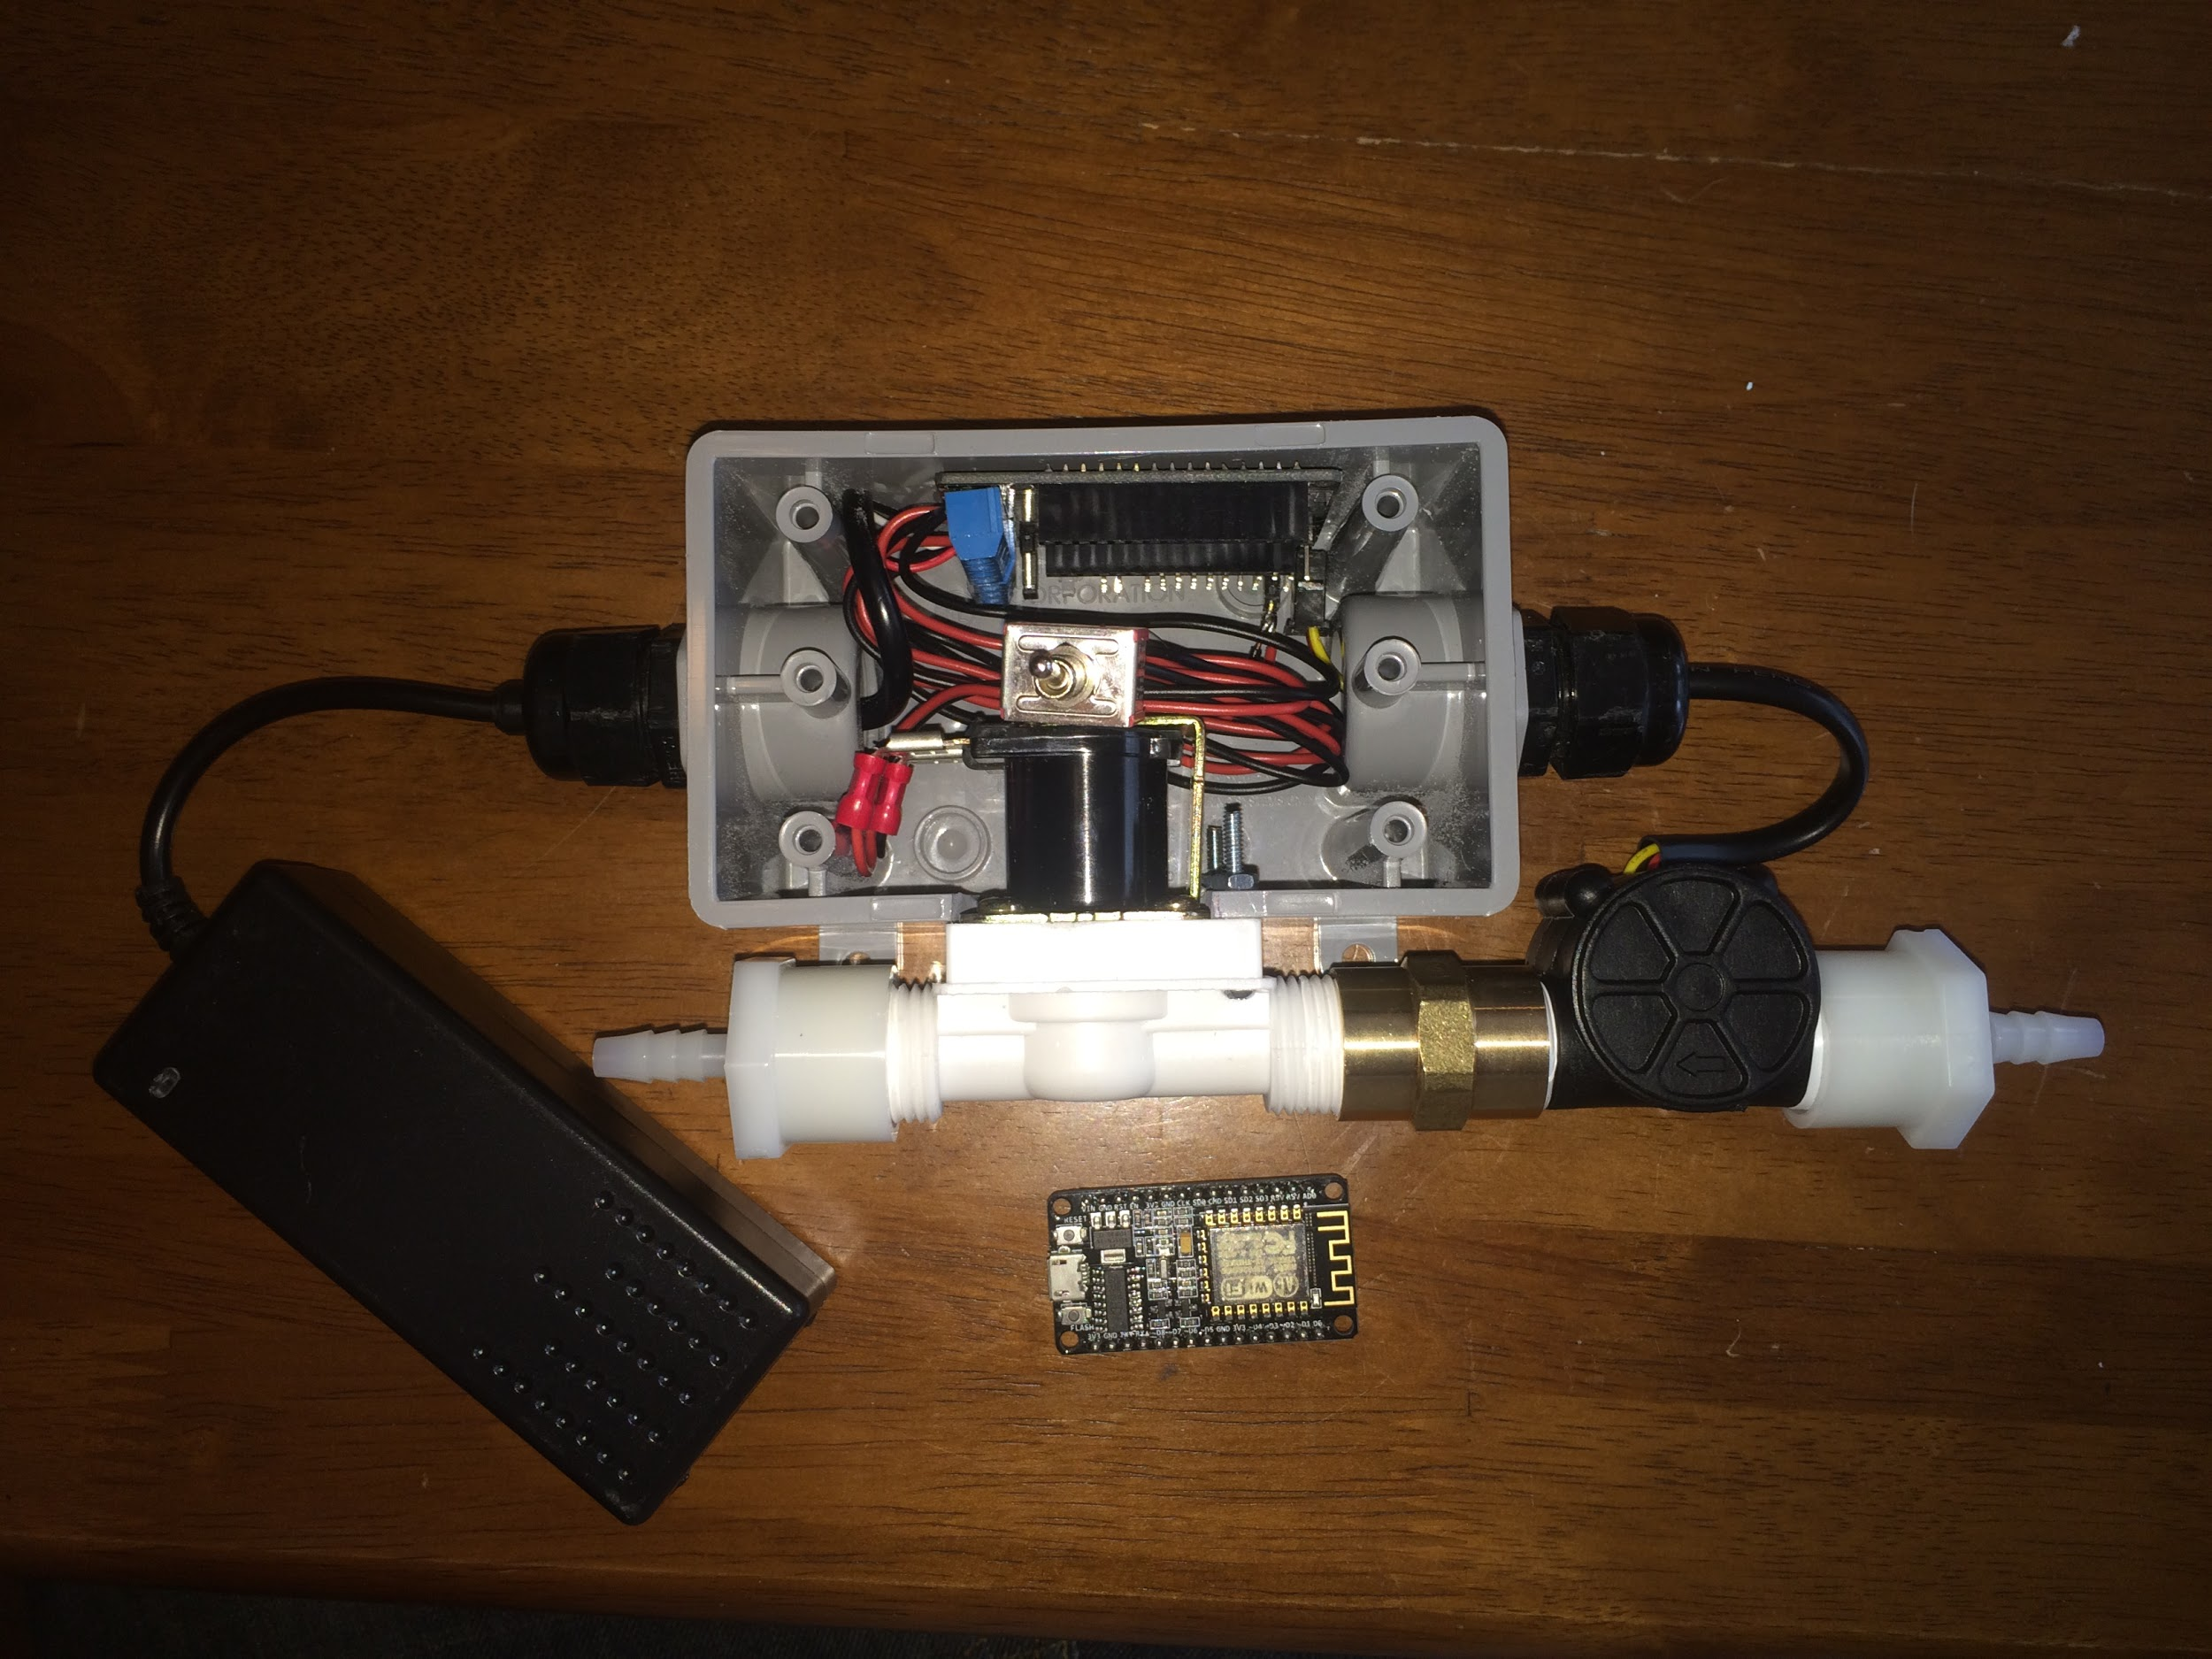
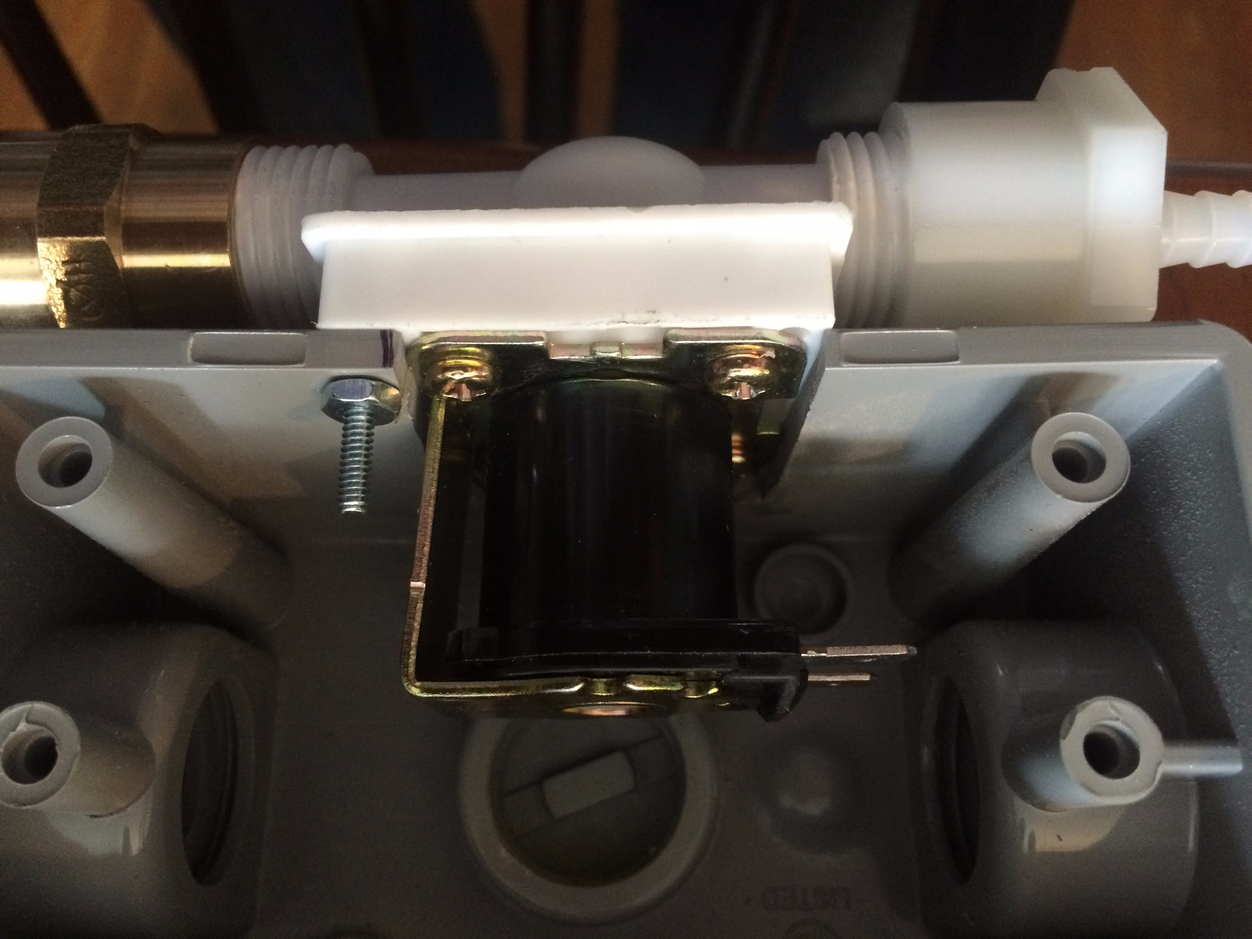
Mechanical Assembly:

Slide 7
Mechanical Assembly:

Slide 8
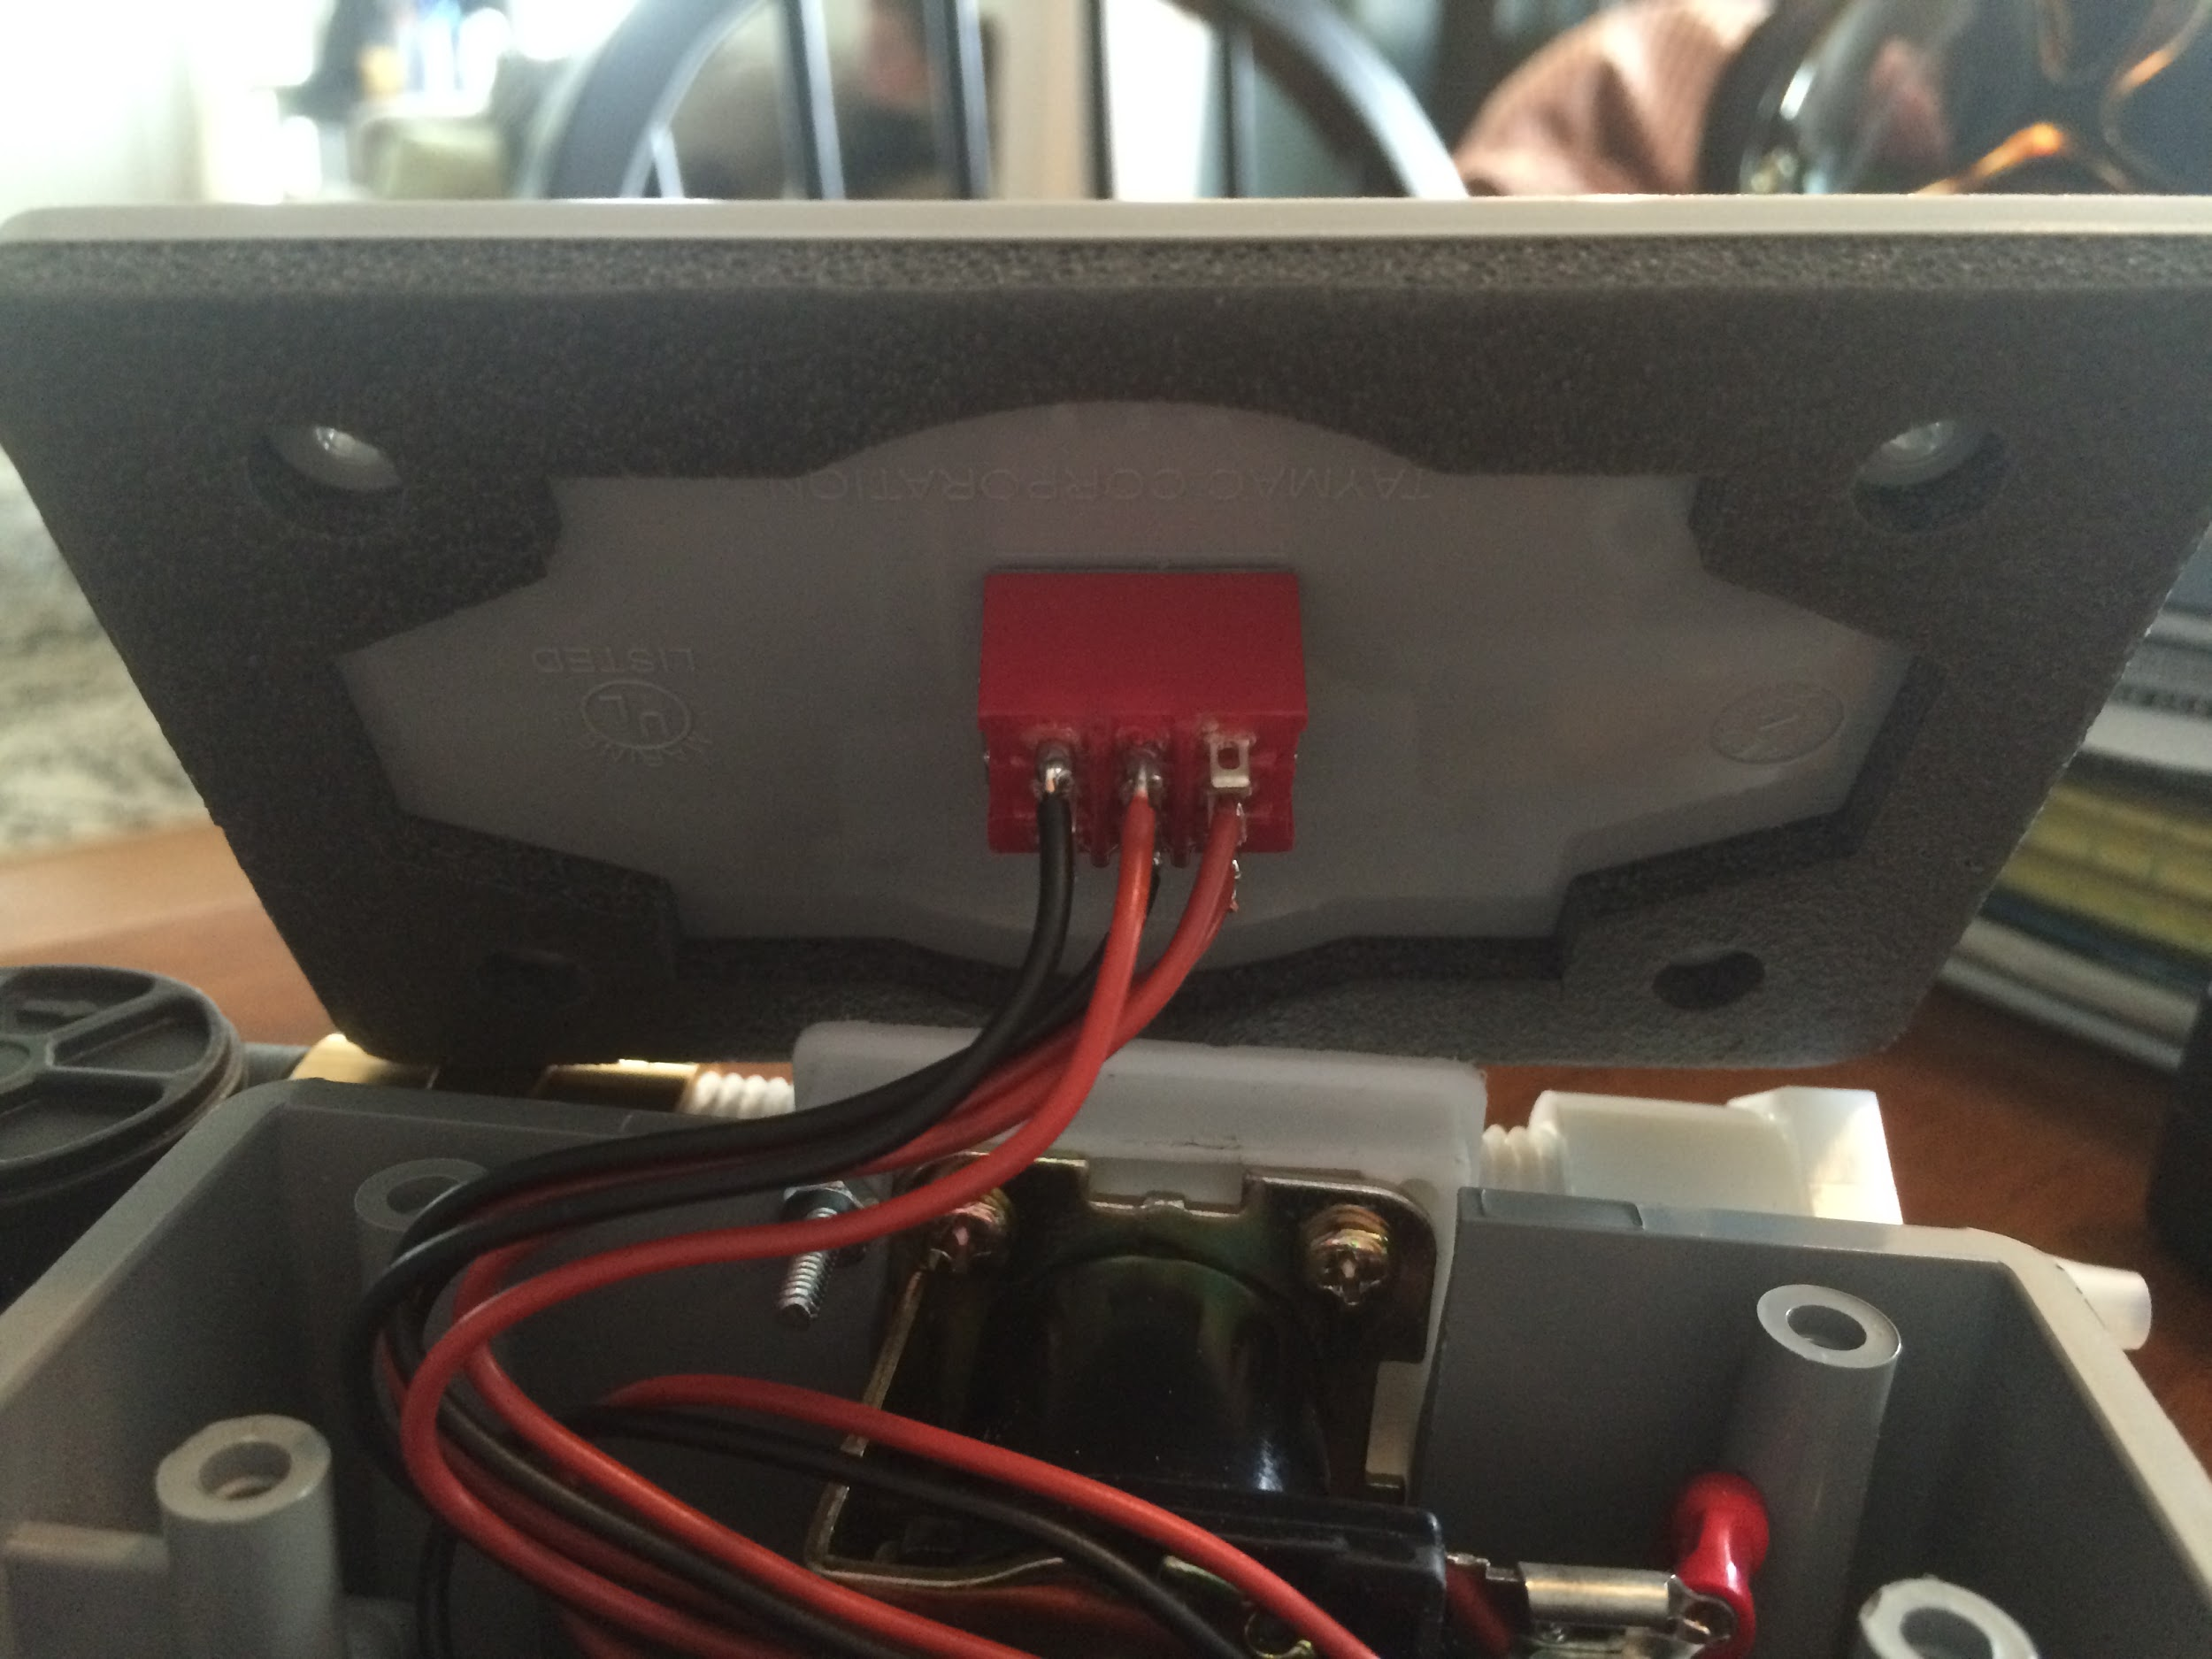
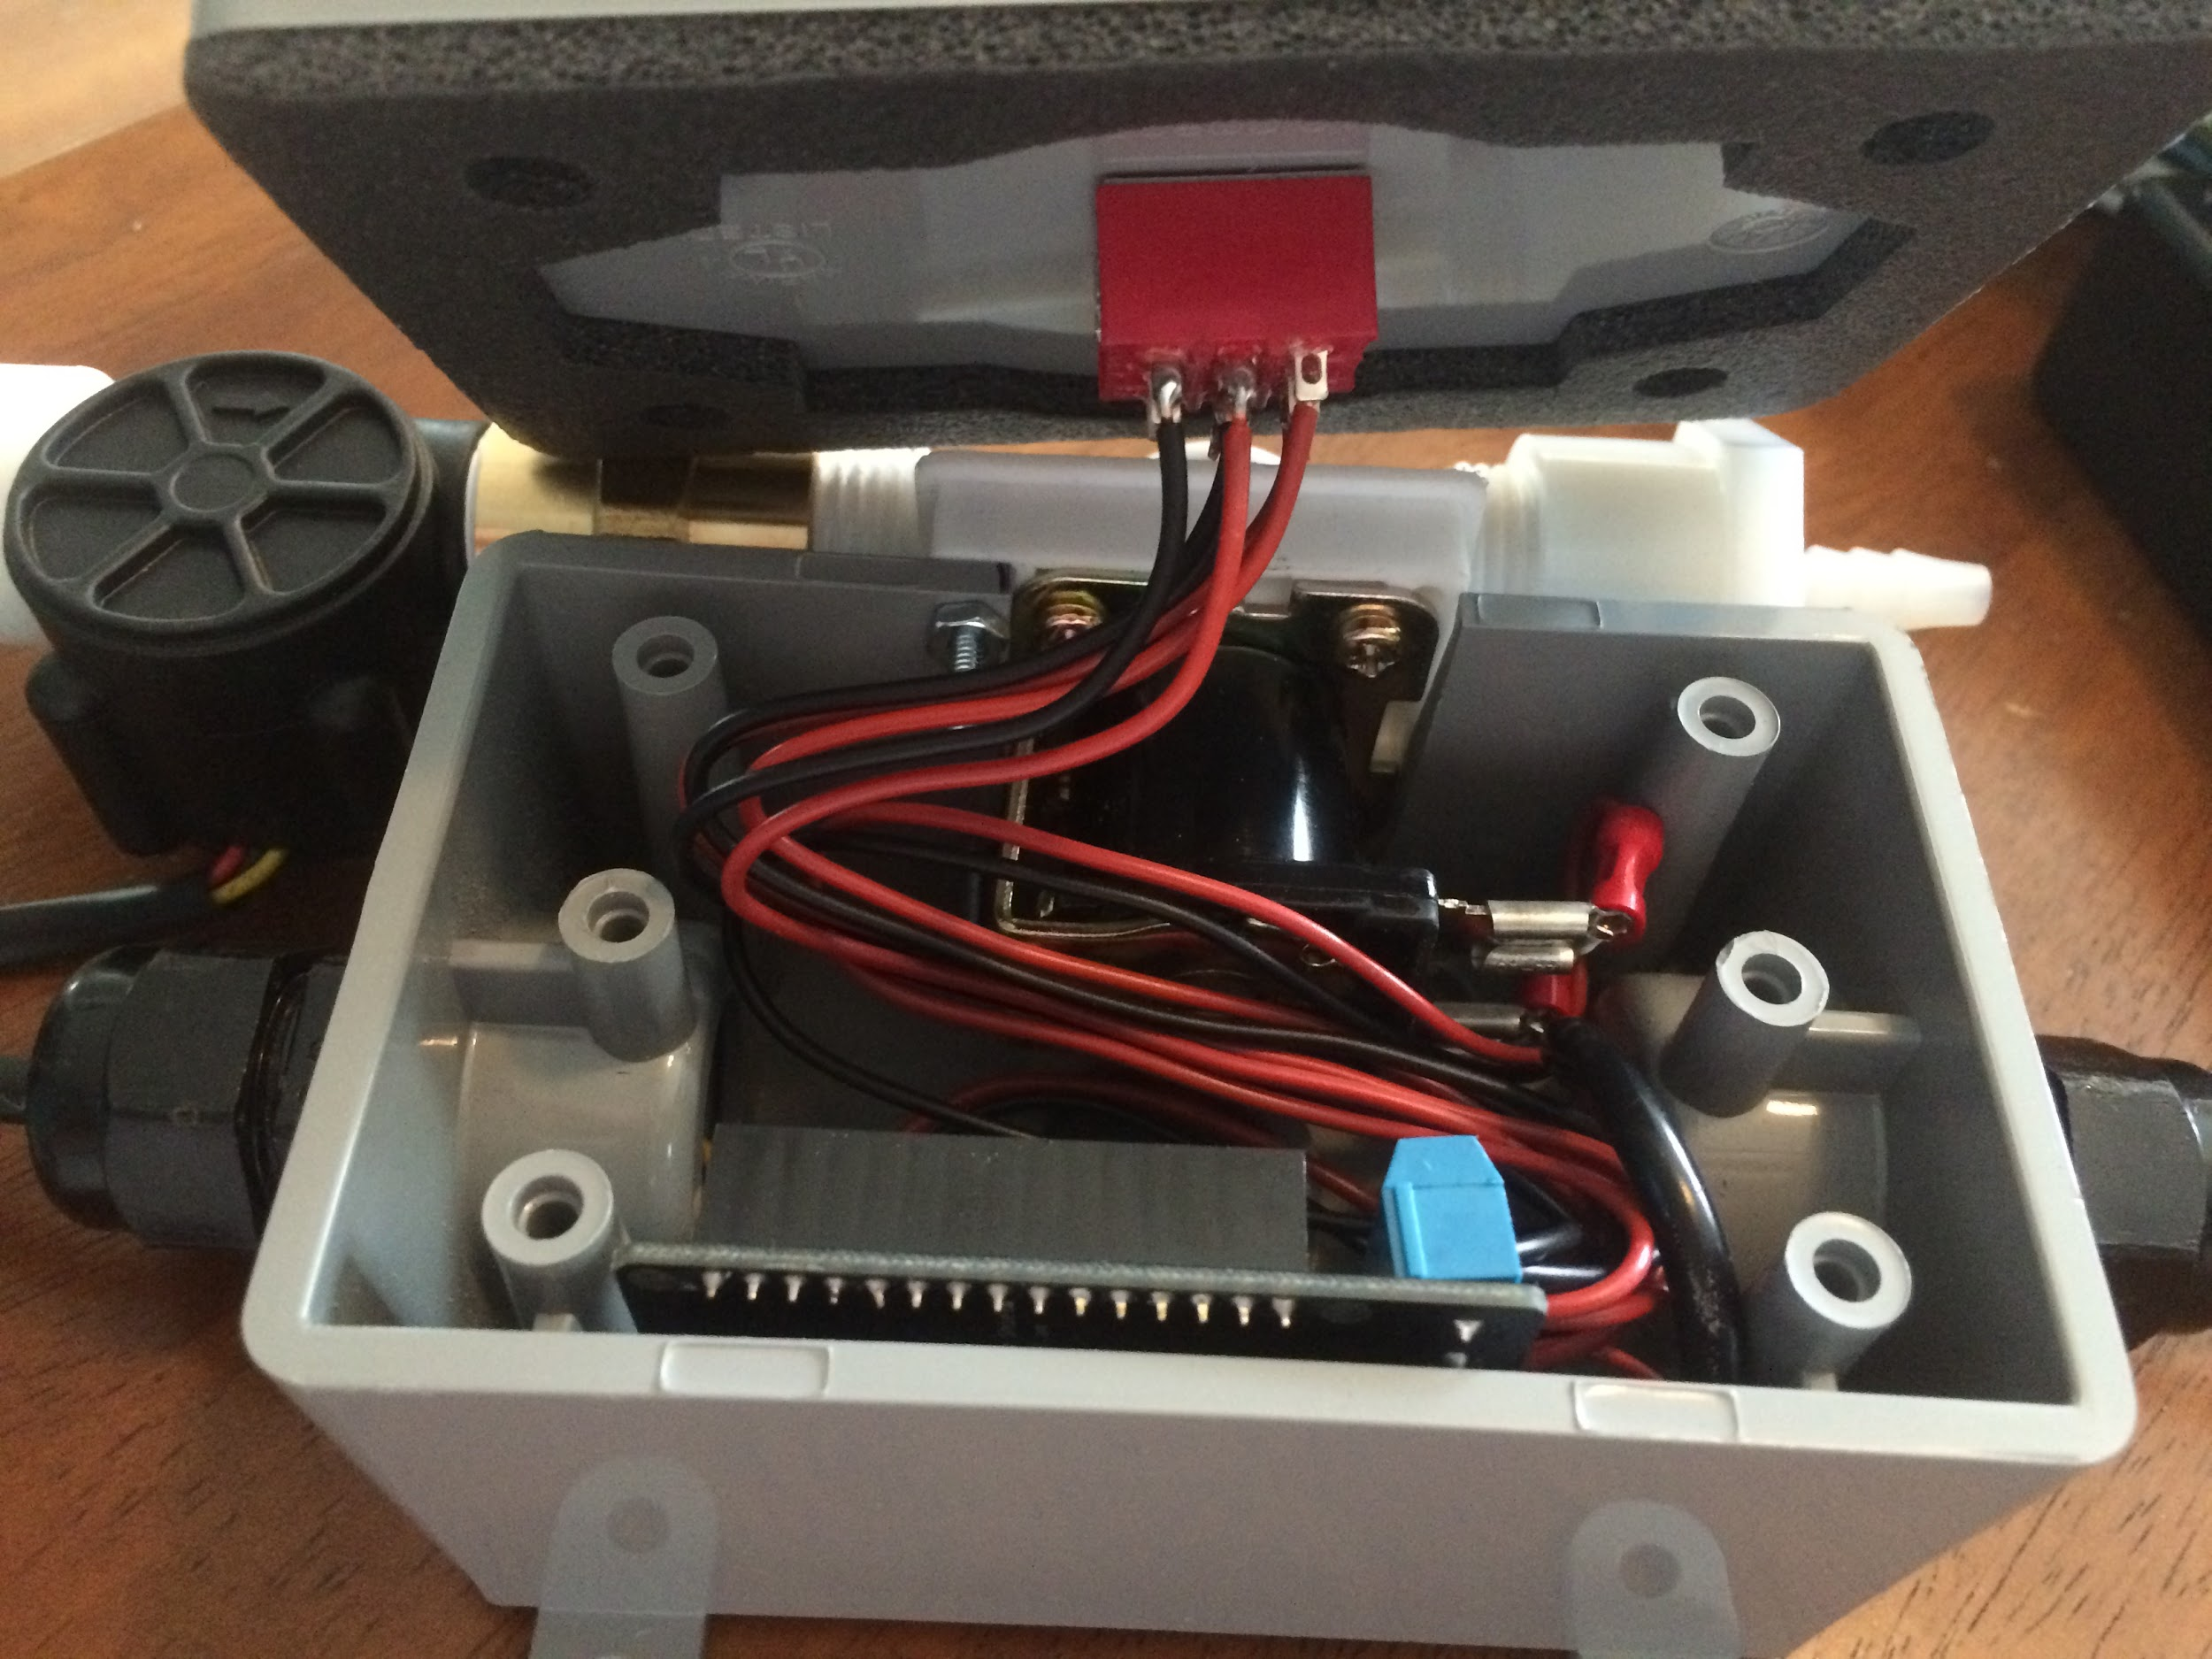
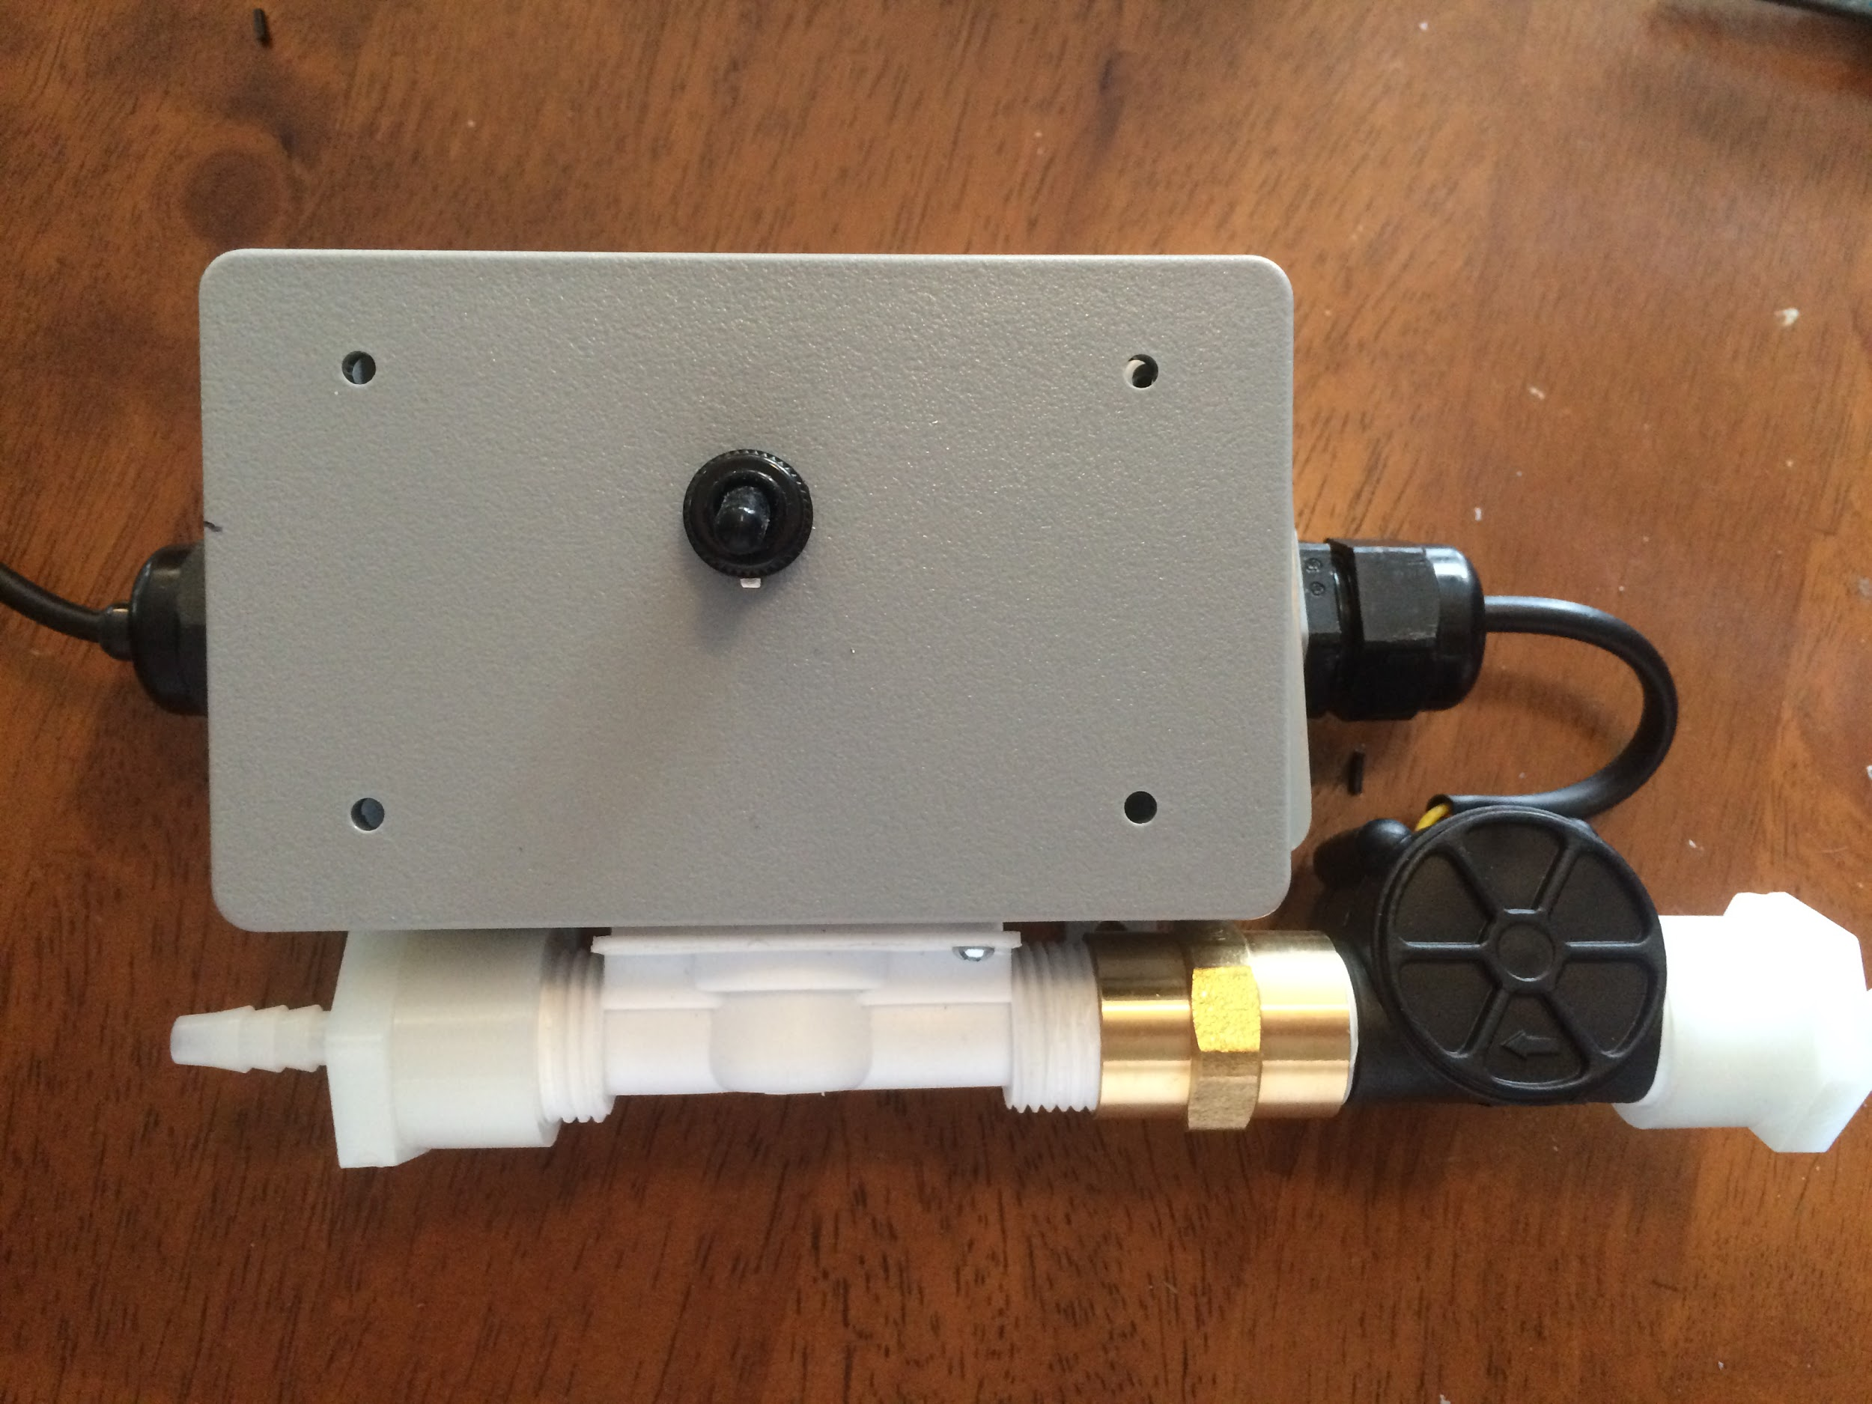
Final Assembly:

Slide 9
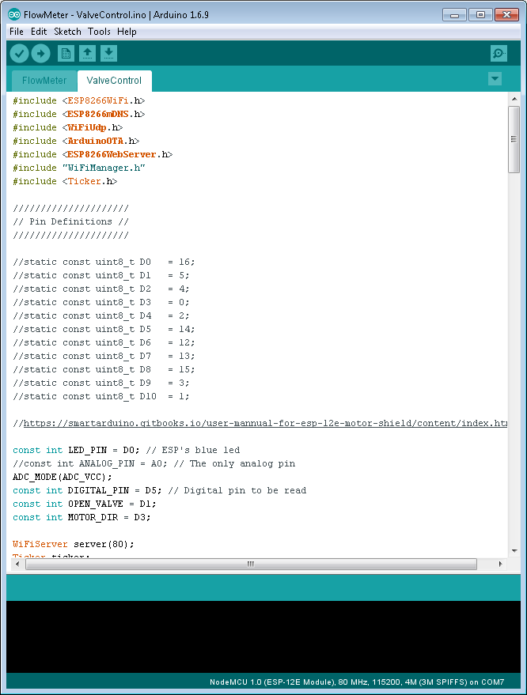
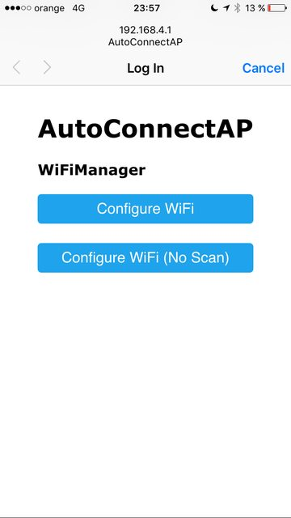
Software:
Arduino IDE:
ESP8266Wifi
ArduinoOTA
ESP8266Webserver
WiFiManager
Ticker

Slide 10
Problems:
Size limitation
Heat dissipation
Visual indication
Serial communication

Slide 11
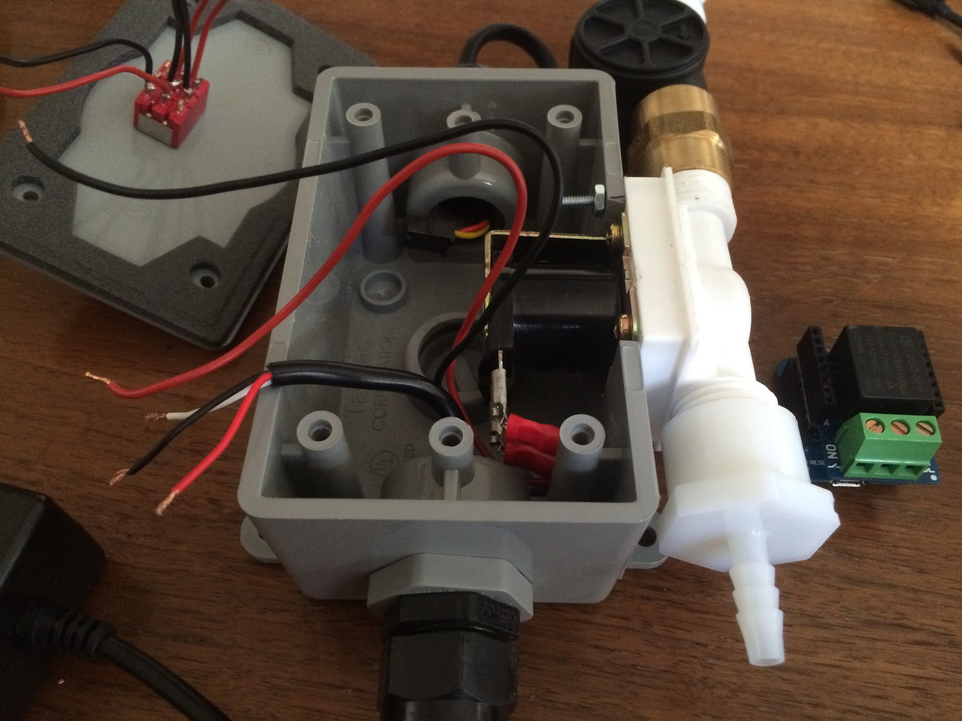
Solutions:
Size limitation
Cut the cord
Heat dissipation
Keg Button
Visual indication
Nmap
Serial communication
Wemos mini

Slide 12
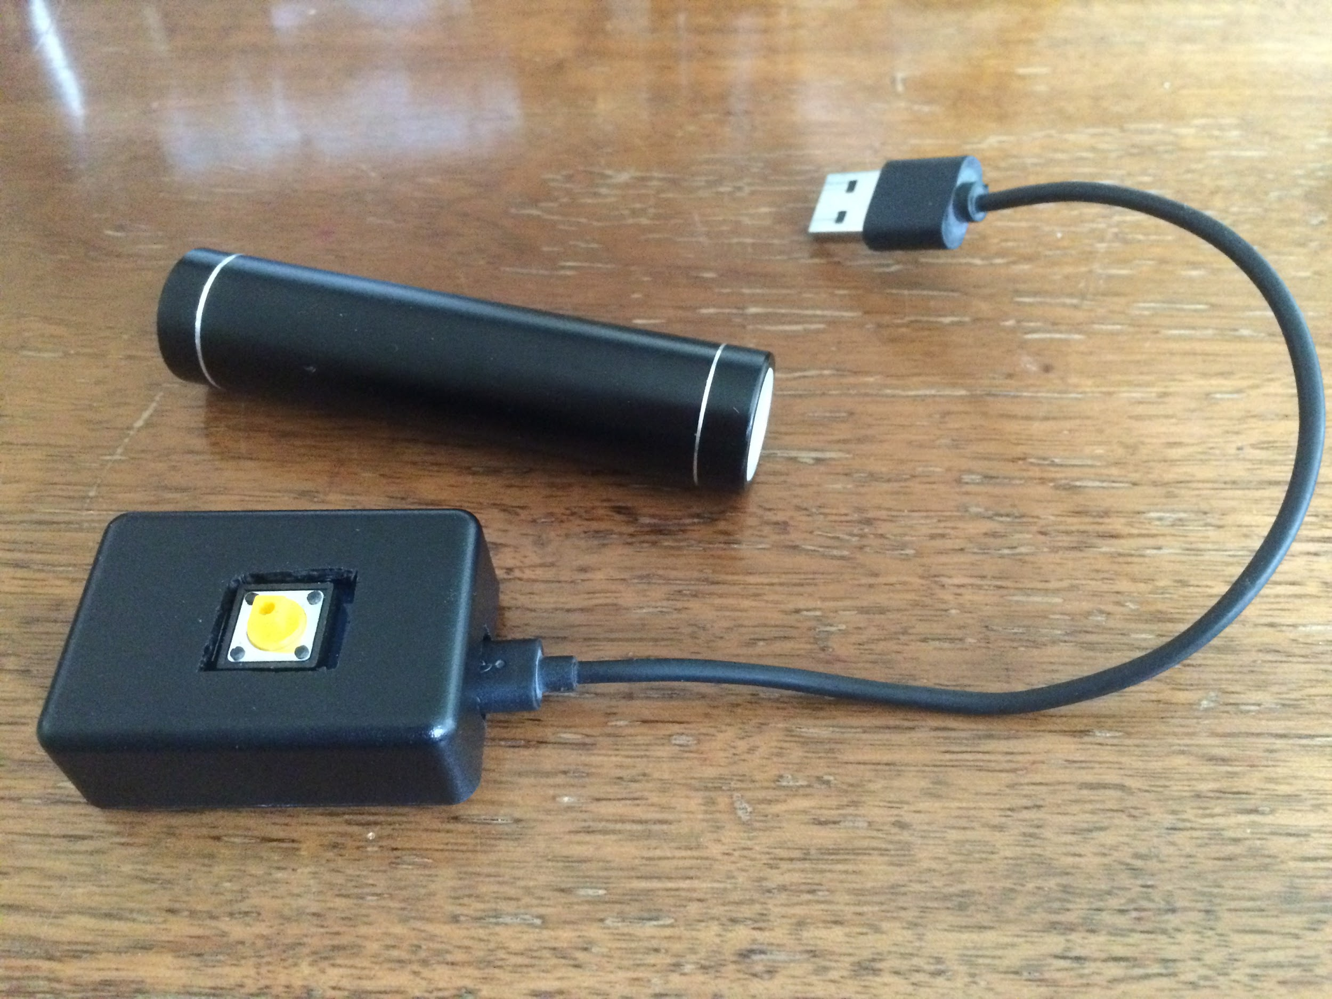
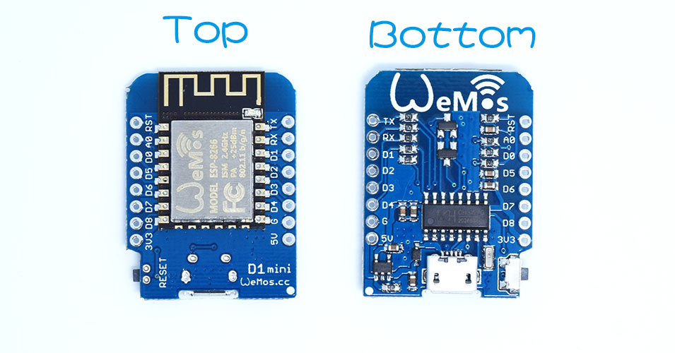
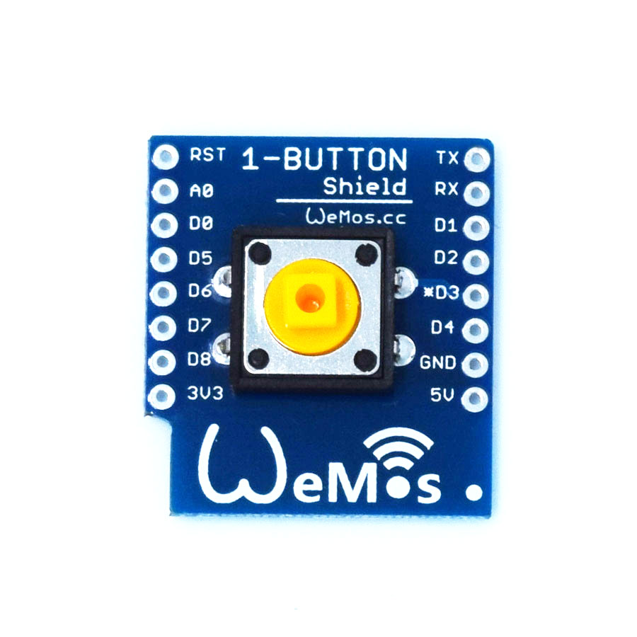
Keg Button:

Slide 13
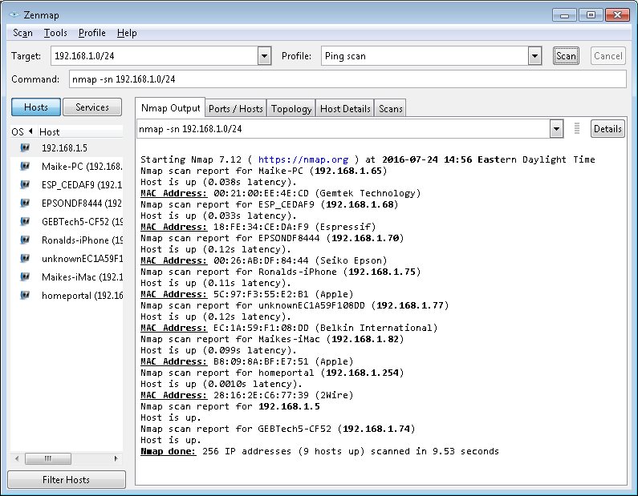
Nmap:

Slide 14
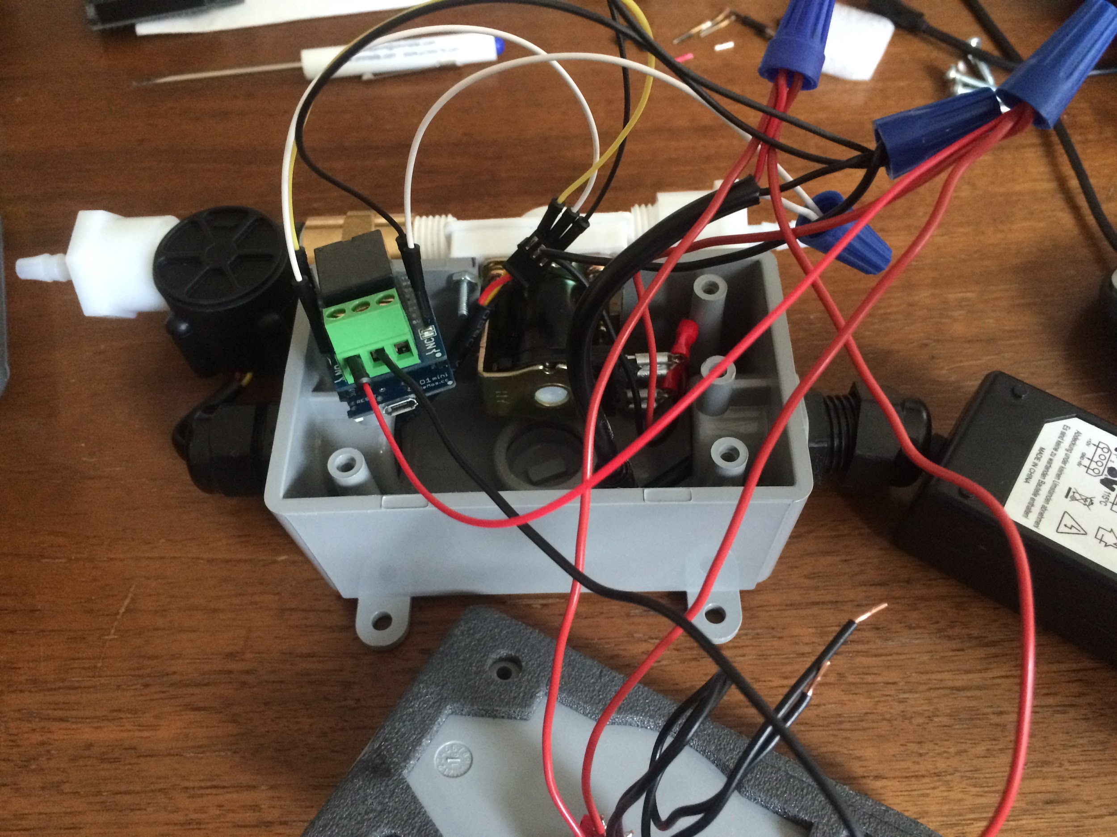
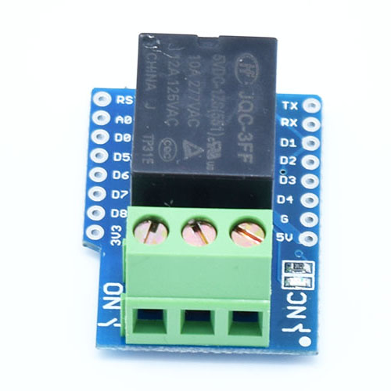
Wemos Mini w/Relay Shield:

Slide 15
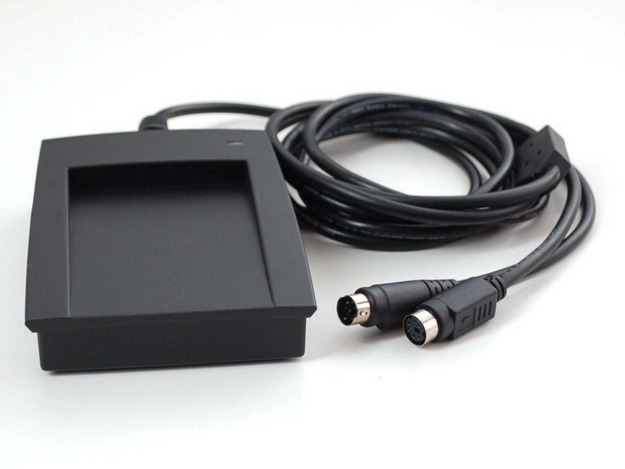
To Do:
Installation
Flow Meter
Card Reader
Error handling
Security

Slide 16

indyopenhardware@gmail.com
@INOpenHardware
indy-ansible-invite.herokuapp.com/she4ytoexq2uiapnsa0x
meetup.com/Indy-Open-Hardware-Meetup github.com/IndyOpenHardware

